Slide 1
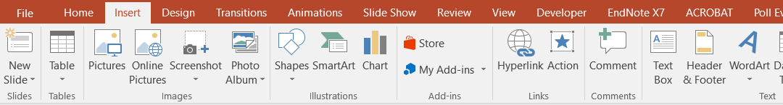
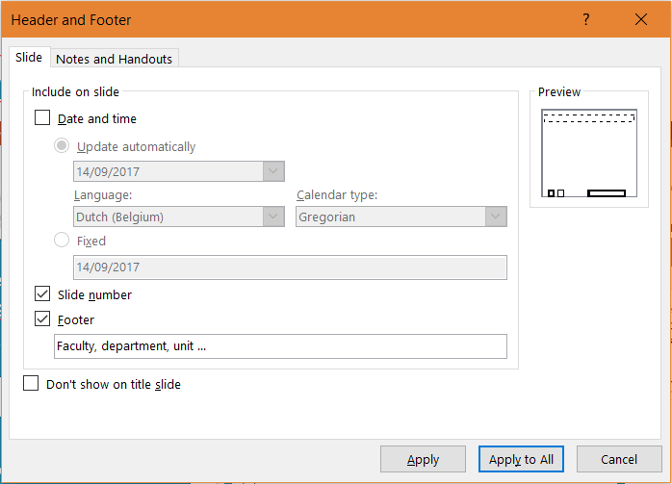
Customise this template: include the name of your faculty, department or unit
To enter the name of your faculty, department or unit: Insert | Header & Footer:
To include your faculty, department or unit on every slide of the presentation, change the default footer and select ‘Apply to All’

Slide 2
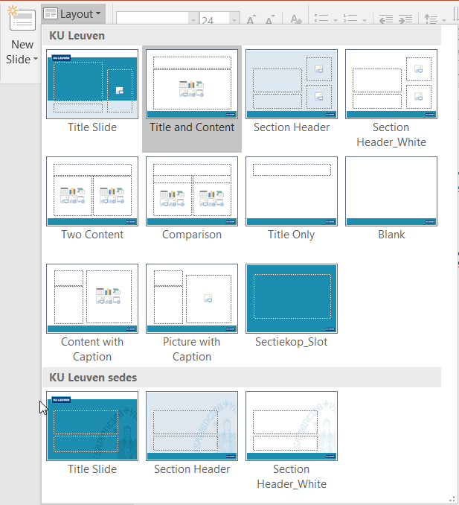
How to use layouts in this template (1)
To choose the layout for a new slide: Home | New Slide
To change the layout of an existing slide: Home | Layout

Slide 3
How to use Layouts in this Template (2)
You can include images on the title slide and the two section headers.
As an alternative to using images layouts with the KU Leuven sedes are available.
This template can be used for existing presentations, but not without changes.
Remove these three instruction slides from your presentation

